Slide 1



2027 RKMC Convention at Sea
Hosted by ON 1 in collaboration with
Expedia Cruises Vaughan
Frequently Asked Questions
About

Slide 2
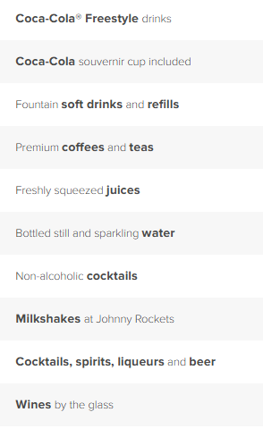
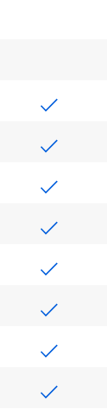

Deluxe Beverage Package

Slide 3
Frequently Asked Questions
Does everyone in the stateroom have to have the deluxe beverage package?
A: Yes, everyone in the room must have the beverage package
2. Can I use my beverage package on Royal Caribbean's private Island, Coco Cay?
A: Yes, you can use your beverage package on Coco Cay as well

Slide 4
Frequently Asked Questions
3. Can I book with my local travel agent or with Royal Caribbean directly?
A: Must book with Expedia Cruises Vaughan to gain access to Expedia Cruises Vaughan sponsored events
4. When do I have to book by?
A: We have secured 217 rooms at the Exclusive Expedia Rate. We must release any unsold rooms by November 25, 2026. Therefore, we recommend booking before all 217 rooms are sold, or before November 25, 2026, whichever comes first.

Slide 5
Frequently Asked Questions
5. What if I am unable to commit to this cruise by November 25, 2026
A: You will still be able to book your 2027 Convention Cruise with Expedia Cruises Vaughan, but the rates will not be the same – most likely higher
6. What do I need to make a booking?
A: $560 CAD deposit per room

Slide 6
Frequently Asked Questions
7. When is the remaining balance due?
A: Remaining cruise balance is due April 23, 2027
8. What drinks are included in the deluxe beverage package plan?
A: Specialty Coffees, Bottled Water, Sparkling Water, Select Alcoholic Beverages, Mocktails, Milkshakes at Johnny Rockets, and Fountain drinks

Slide 7
Frequently Asked Questions
9. How can I pay?
A: Deposit and Final Payment is via PayPal. If you need a payment plan, that can be arranged also. If you have concerns, please contact pthai@expediacruises.com.
10. What is the incentive to book with Expedia Cruises Vaughan?
A: Booking as part of our negotiated group rate enhances the group's business value and visibility with Royal Caribbean. This helps the cruise line better recognize RKMC and can create opportunities for additional amenities, exclusive benefits, and added value for everyone booked into the group

Slide 8

2027 Convention Contact Details
Website: www.expediacruises.ca/vaughan
Phone: 905-850-7900
Contact: Phuong Thai (pthai@expediacruises.com)
Contact: Mike Nandkishur (mnandkishur@expediacruises.com)

