Slide 1


Slide 2
SAFETY FIRST
FIRST FACT TO REMEMBER:
MOTORCYCLE RIDING BY IT’S NATURE IS DANGEROUS
SECOND FACT TO REMEMBER:
TRAIN AND BE PREPARED

Slide 3
Objective
The objective of the Team Riding Course is to provide Members with the education and information that will enable them to be better prepared and equipped to lead and participate in safe Team Rides.

Slide 4
Agenda
We will have a classroom segment for about 2 ½ hours where we go over the following:
  Introduction
  Team Riding Terms
  Guidelines
  Hand Signals
  Question and answer period

Slide 5
Overview
  What is a Road Captain?
  Safety
  Team Riding Review
  Planning the Ride
  Day of the Ride
  The Ride
  Hand-and-Arm Signals
  Q/A

Slide 6
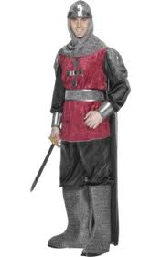
What is a Road Captain?
A Road Captain is…..
  A leader capable of setting up a ride according to the Team Riding Guidelines.
  A Ride Leader trained in how to lead a Team Ride
  A Ride Leader Trained in how to fulfill the duties of “drag” the correct way.

Slide 7
ROAD CAPTAIN
Road Captain: Description of a Road Captain is pretty simple. He/She will either lead or assist on rides. An important point I would like to make is that the word LEAD is a misnomer. Anyone can lead a group of bikes, but the Lead RC must be able to MANAGE the group. Here is where the challenge lies.
Pre-Ride:
Plan Route, Gas stops, Rest breaks, and food ( Plan stop about every 80-100 Miles)
If ride involves staying overnight, provide lodging information earlier than 1 month.
Provide printed route details and maps to all Road Captains assisting in ride.
. Pre ride route shortly before ride if possible to check for:
    Road work or hazardous road conditions, detours
    Gas and restroom facilities (Choose areas with multiple pumps and restrooms) 6 I recommend each RC to carry safety flares and a basic first aid kit
If unable to lead the ride, find an alternate lead Road Captain and notify SRC.

Slide 8
ROAD CAPTAIN
Day of Ride
Cancel ride if conditions are not safe (weather conditions, etc )
Arrive at departing location early.
Collect tolls if necessary (Suggest using stickers on the headlights to identify paid riders).
Along with other Road Captains insure the safety of all riders while on the ride. (see Road Rule)
Arrange for rear and middle Road Captain support if available.
Insure all non-members and minors have executed waivers.
Conduct Pre-ride Briefing (use laminated briefing card)
Request new riders ride up front.
Have all riders mount their bikes, check that everyone is ready (if you have a CB, call rear RC. If not, visually check), then pull out, STOP a short distance away to make sure all riders are ready, then proceed on the ride.
If you are the designated RC to stop if someone breaks down, YOU will stay with that rider as long as it takes to get him or her going or to a repair facility –
    NO EXCEPTIONS. WE WILL NOT LEAVE ANYONE!!

Slide 9
ROAD CAPTAIN
When pulling away after stopping at a traffic signal, etc, DO NOT HAUL BUTT. Remember, everyone behind you has to stop or at lease proceed with caution through the intersection. Watch the group using your mirrors.
If an unsafe situation occurs by a rider(s):
    Take responsible rider(s) aside at the first stop and attempt to resolve problem.
    If the problem cannot be corrected, have the rider/s/ removed from the ride. If this causes a problem, terminate ride and contact the SRC.
In the unlikely event there is an accident.
    Assign specific responsibilities as appropriate (someone to direct traffic, call 911, first Aid). All other riders should go to a safe location away from the accident.
Once the ride ends, the Lead RC should be familiar with the area in order to provide directions for anyone to return home.

Slide 10
ROAD CAPTAIN
Please Remember: As Lead Road Captain your first priority is to insure that the ride is safe and enjoyable for all riders.
Also, as Lead Road Captain you are COMPLETELY in charge of all riders. As such, you should constantly be looking for trouble (oncoming traffic, road hazards, traffic from side roads, watching the bikes in your mirrors, anticipating traffic signals, if the weather turns bad, find a safe location to pull over).
Not a requirement, but a strong suggestion that all Road Captains successfully complete the Advanced Motorcycle Safety course.
I also recommend RCs have CB radios for ease of communicating.

Slide 11
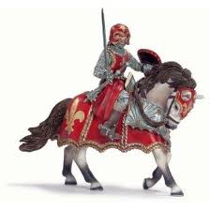
Who should be Road Captains?
  All Chapter Officers, Rider Educators, and Ride Coordinators.
  Any Rider who may happen to lead Organized rides, Dinner rides, etc.
  Anyone wanting to further his or her knowledge of Team Riding.
  Finally, to be a Road Captain is a privilege earned, not just a Patch on your vest. There is a tremendous amount of responsibility on you and not everyone is ready.

Slide 12
BASIC SAFETY FIRST
(not involved)
Scene safety first – stop, park, kick stand down, engine off, pause 1-2 seconds and access the scene.
You are not required to stop to render assistance at the scene of an accident.
Consider the rest of the group and continue to your destination or a place where everyone can safety stop.
If you do stop and offer first aid, you are not liable under the Good Samaritan Act as long as you only do what you have been trained to do.

Slide 13
BASIC FIRST AID
(involved)
However, if it’s one of our group involved in an accident, the Rear RC will be in charge because the Lead RC won’t know it happened, possibly. Someone has to in charge.
You will need to designate only a few others to assist. Designate someone who knows where you are to call 9-11; designate someone to assist the injured rider/s/ if not you, and designate someone to get the rest of the riders out of the way, preferably to your original destination or to a safe place where they can stop/wait.
All assisting the injured should put on the exam gloves for your own safety.

Slide 14
BASIC SAFETY FIRST
Stabilize the head and neck and NEVER release until professional help arrives. You will need to designate someone to do this.
Whoever is the one assisting the injured, first check the ABCs (airway, breathing, circulation). AVPU – (Alert, Verbal response, Painful response, Unresponsive)
If the patient is awake and breathing that’s good. Tell the injured NOT to move and assure him/her that professional help is on the way. If awake, ask them where they hurt. Do NOT move the injured if they are awake, tell them NOT to move. Tell them to answer your questions with a YES or NO and NOT move their head. If not breathing, check for a pulse by using your two fingers placed on the carotid artery on the side of their neck.

Slide 15
BASIC SAFETY FIRST
If there is bleeding, blood flowing from an injury, it’s a vein, if it’s pumping blood, it’s and artery. Either way, applying direct pressure on the wound is the ONLY thing you should do. Put on your exam gloves first (NOT you M/C gloves, then the dressing. DO NOT remove whatever you’re using. If it becomes soaked with blood, put more bandages or whatever you have on top of the bloody one. If no broken bones are visible, raising the arm or leg that is bleeding will help.
Drug stores sell Non-latex gloves. They are also great in the winter inside your regular gloves for keeping your hand warm.
Always reassure the injured that help is on the way.

Slide 16
BASIC FIRST AID
If the injured has broken bones, do not attempt anything other than stabilizing the head/neck and bleeding
Do not move the injured unless he/she is not breathing. You may have to roll the injured over on their back. (demonstrate how).
Helmet removal is not necessary since mouth to mouth is no longer part of CPR. Full face helmets, recommend raising the lid so the injured is more comfortable. Hospital staffs prefer the patient arrive with the helmet on.
I suggest each RC can make their own. Large zip lock bag with some sort of absorbing pads such “trauma dressings from a drug store, Kotext or similar product will work. A space blanket purchased at a surplus store, camping, even Wal-Mart, Target, etc. carry them, and of course non-latex gloves. The space blanket has many uses. Protecting the injured, warming the injured, and shielding the injured.

Slide 17
BASIC FIRST AID
Remember that the injured may go into shock (Hyper fusion). Signs of shock: altered mental status, cool/clammy skin, nausea, labored breathing, rapid pulse. Use the thermal blanket, and can raise the legs slightly if not injured
Most injured will be concerned about their ride and will not won’t to go to the hospital. You cannot make them either, but it is to their advantage.

Slide 18
BASIC FIRST AID
Other concerns: Heat stroke and heat exhaustion could be a problem during hot summers. Lead RC should consider stopping more often for liquids. When you stop, walk around and checkout the riders. Same holds true in cold weather with hypothermia.
Signs of heat stroke (hyperthermia) hot, dry or even moist skin, rapid pulse, weakness, cramps, no sweating. Get out of the heat, cool compresses to the forehead and wrist, hydrate as needed.
Signs of hypothermia: No shivering, stiffness, drowsiness. Warm up slowly, do not rub the affected area, fingers can be put in armpits. Even if the weather seems warm, the wind-chill factor can cause hypothermia

Slide 19
Why a Team?
  Mass Riding
    Everyone does their own thing.
  Leisure Riding
    Riders have a basic idea of each other’s styles.
  Team Riding
    Structured planning and ride conduct.
    Having a set “Rules of the Road”
    Actively working together to make the ride safer, more relaxing, and more enjoyable.

Slide 20
Team Responsibilities
All Riders Responsibilities
Lead Bike Responsibilities
Drag Bike Responsibilities
Team Member Responsibilities

Slide 21
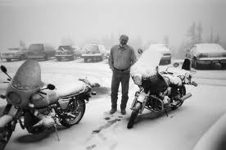
All Riders Responsibilities
Arrive on time
  Full tank and empty bladder(full stomach?)
Complete pre-ride check
  Bike known to be in good condition (T-CLOCS)
Be prepared with essentials
  First Aid kit, Raingear, extra clothing, Emergency contact info, Cell phone
Inform coordinator of any special needs
  Diabetes, Bladder or Back problems, etc.

Slide 22
T-CLOCS
T Tires, Proper Pressure/Tread
C Controls, Throttle, Levers, Cables, Switches
L Lights, High/Low beams, Signals, Brakes
O Oil, Do you have it? If so, proper amount
C Chassis, Air Shocks? Belt/Chain?
S Stand, Check spring and adjustment

Slide 23
Lead Bike Responsibilities
Should be experienced
Be able to make quick, safe decisions
Pick his/her Drag Bike
Sets the tone for the ride
Maintains communications
Communicates any changes(speed, lane, etc)
Adheres to the schedule
Listens to Team Members

Slide 24
Drag Bike Responsibilities
Controls general conduct of the ride
Ensures that the team is abiding by the rules
Drops off to assist Team Members or public (preferably has first aid kit)
Address any unusual riding action
Secure lanes for the Team
Communicate with ‘Lead’
Controls the pace of the ride

Slide 25
Team Member Responsibilities
Ride their own ride
Arrives prepared and ready
Communicates any change in position
Maintains proper spacing and position
Follow ‘Lead’ and ‘Drag’ instructions
Minimize CB traffic when appropriate
Makes certain that they have the ride information
Communicates issues or concerns to the ‘Lead’ or ‘Drag’

Slide 26
Planning and Preparation
Plan the Route
Plan the Stops
Plan the Breaks
Plan the Speed
Plan the Teams
Plan the Start
Plan to Inform
Start Prepared

Slide 27
Day of the Ride
Arrive at the starting location ahead of time
Position the bikes as they arrive
Size the groups and select leaders
Do a safety check
  Do not endanger the group with a single bike having major defects or safety issues
Plan to accommodate Solo Riders
Review the 3 primary hand signals
Stage all groups five minutes before departure
Select CB channels and do a radio check

Slide 28
The Ride
Communicate your intentions verbally or physically
‘Lead’ and ‘Drag’ work as a Team
Communicate with the Group
CB chatter
Group Spacing
Group Communication

Slide 29
‘The Ride’ FACTS
IMPORTANT
  During any team maneuver, it’s always the responsibility of the individual rider to check for the safety of a move before executing it.
  Never take anyone else’s word that a lane is clear or it is safe to pass
  Always do a head check. Don’t depend on mirrors.

Slide 30
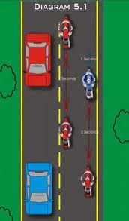
‘The Ride’ ---Staggered
Mentally divide lane into thirds
  Lead bike in left track
  Bike #2 in right track > 1 sec.
  Bike #3 in left track > 2 sec.
  And so on…..
Allows time and space to react
Adjust distance to conditions (rain,night)
  Double the following distance
Only the ‘Lead’ bike uses High Beams

Slide 31
‘The Ride’ Single File
When in curves or winding roads
When road is narrow or no shoulder
When approaching blind hills
When passing semi’s in either direction
When hazards are present
Always remember Minimum 2 second rule

Slide 32
‘The Ride’ Merging
When entering traffic from an on-ramp, You should enter as quickly and safely as possible.
  Don’t try to get fancy, Just get out safely
Don’t attempt to block a lane with your motorcycle. It is illegal and certainly dangerous
Each bike picks their own merge point in traffic, then safely moves into it.
‘Drag’ bike is last out and notifies ‘Lead’ of progress of unification

Slide 33
‘The Ride’ Lane Changes
‘Lead’ asks ‘Drag’ “move to left/right when clear”
‘Drag’ checks traffic behind. If not clear gives “standby” When clear, moves to left/right and announces “lane is secure”
‘Lead’ bike announces, “look left/right” move “left/right” Move as you see it is safe.
Others follow in order, or all together.
Follow the leader! Do not move over until the bike in front of you moves.

Slide 34
‘The Ride’ Passing
This is only done when it is SAFE, LEGAL, AND NECESSARY!!!
‘Lead’ notifies the Team to pass single file.
Only done one-at-a-time
‘Lead’ does mirror and head check, turn signal and passes
After ‘Lead’ pulls back into lane he moves ahead to leave room for remaining bikes to return to lane
When safe, 2nd bike follows same procedure, and so on.
When ‘Drag’ bike is safely around he advises ‘Lead’ all have passed safely.

Slide 35
‘The Ride’ Traffic Lights
When stopped for a traffic light use “compressed” staggered formation.
Bike #2 is about 3 feet back from ‘Lead’ so ‘Lead’ has a clear view in both directions.
Normal staggered formation resumes when Team begins moving.
From a stop, ‘Lead’ bike should start out slow to keep the group together

Slide 36

‘The Ride’ Hazards
Leader should always point to the hazard
If you can call out on the radio
  Call out “Road Dirt” or “Debris” left, center, right
    “Road Dirt Left”
    “Debris Right”
    “Hole Center”
Each team member is responsible to pass it down the line

Slide 37
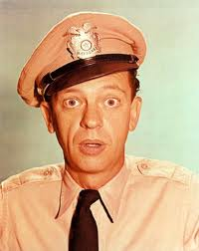
‘The Ride’ Towns
When Traveling through towns, the group may get broken up at traffic lights. There are several ways to handle this:
  If the route is known, regroup on the other side of town.
  The ‘Lead’ may safely pullover to wait on the rest to clear the light or obstacle.
  ‘Lead’ should call out each turn or change of direction just prior to doing it. ‘Drag’ notifies of group status.
There will be a new temporary ‘lead’ and ‘drag’ because of the group getting split

Slide 38
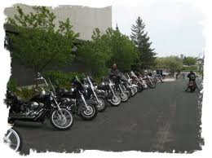
‘The Ride’ Parking Lots
Quickly move as far off the road as possible
  This gets the bikes off the road safely into the parking lot
If possible, all bikes stay in line and use same row of parking spots and same parking procedure.(this really looks professional)
NEVER LEAVE BIKES STRANDED ON ROADWAY!!

Slide 39
‘The Ride’ Riders Leaving
If possible communicate beforehand to Road Captain to avoid confusion.
Position toward rear of group.
Split from group before your turn.
Have replacement for early departure of ‘Drag’ or ‘Lead’
Plan Ahead

Slide 40
‘The Ride’ Emergencies
Accidents
  Follow motorcycle crash scene response protocol
Mechanical issues
  The rider verbally notifies or uses hand signals to indicate problem.
  Only the ‘Drag’ pulls over with the disabled bike.
  The ‘Lead’ should find a safe place to pull the rest of the group off(Exit Ramp, Parking Lot, etc)
Phone calls
  NOT AN EMERGENCY

Slide 41
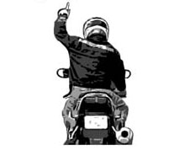
Hand Signals
Single File
Arm and Index finger extended straight up

Slide 42
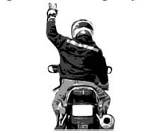
Hand Signals
‘Staggered formation’
Arm extended straight up. First and fourth fingers extended forming “ram’s horn”

Slide 43
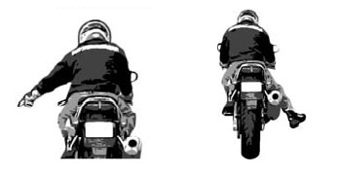
Hand Signals
‘Hazard on road’
Point immediately, with emphasis to the track the object is in.
Can be done with right or left hand or leg

Slide 44
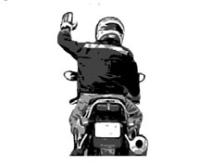
Hand Signals
‘Follow Me’
Arm extended straight from shoulder, palm forward

Slide 45
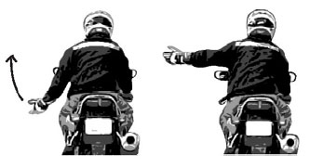
Hand Signals
‘Speed Up’
Arm down to side. Fist Clinched, Rotate, Twist hand as if turning throttle

Slide 46
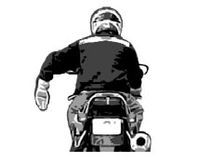
Hand Signals
‘Stop’
Arm extended down, Palm Back

Slide 47
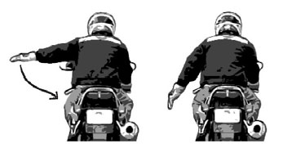
Hand Signals
‘Slow Down’
Arm Extended straight out from shoulder moving down repeatedly

Slide 48
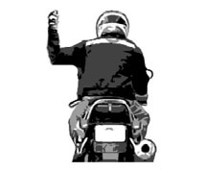
Hand Signals
‘Right Turn’
Arm out, elbow bent, hand straight up as fist.

Slide 49
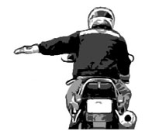
Hand Signals
‘Left Turn’
Arm straight out from body, palm flat.

Slide 50
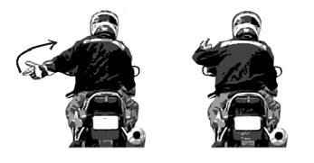
Hand Signals
‘You Lead, come around’
Arm extended down, Palm forward, swinging forward from hip in arc.

Slide 51
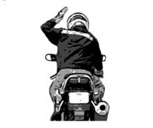
Hand Signals
I am OK, No problem
Tap on helmet with open hand, Palm down

Slide 52
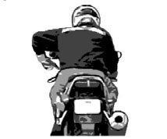
Hand Signals
‘Need Fuel’
Arm out to side point to fuel tank.

Slide 53
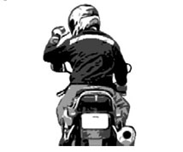
Hand Signals
‘Food/Drink Stop’
Arm out to side, thumb to mouth.

Slide 54
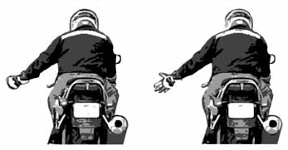
Hand Signals
‘Turn Signal left on’
Repeatedly open and close hand with fingers extended

Slide 55
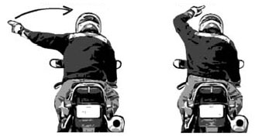
Hand Signals
‘Pull Off’
Arm out, swing toward shoulder or pull off, exit.

Slide 56
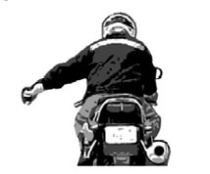
Hand Signals
‘Need Comfort stop’
Forearm extended, fist clenched with up and down movement. To say wrist tired need break.

Slide 57
Riding Equipment Do’s
Helmet
Gloves
Jacket
Boots
Long Pants
Eye Protection
Medical Information Sheet

Slide 58
The following slides are very graphic and may be uncomfortable to view

Slide 59
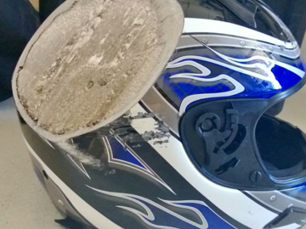
What a helmet looks like after sliding down the road
Better that your head

Slide 60
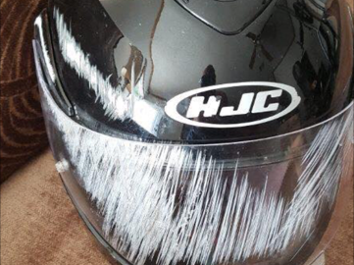
Save your face
It is your choice

Slide 61
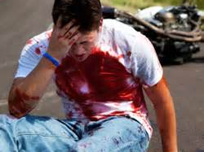
Helmets are to hot to wear
Is it really to hot?

Slide 62
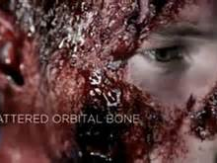
I don’t need a helmet
Or my face

Slide 63
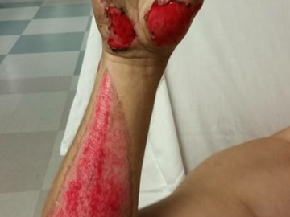
I DO NOT NEED GLOVES OR A JACKET
GLOVES CAN SAVE YOUR HANDS

Slide 64
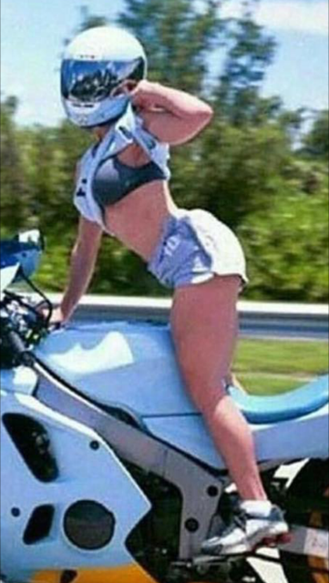

Slide 65
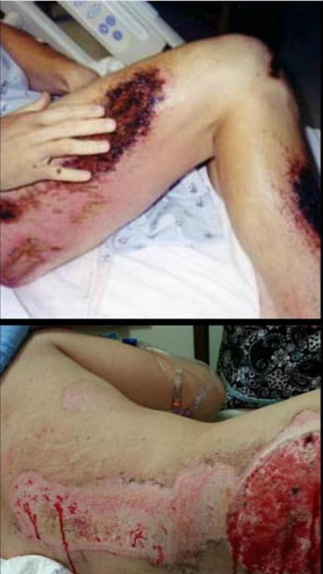

Slide 66
RKMC MEDICAL INFORMATION FORM
RKMC MEDICAL DATA HELMET STICKER
AIR MED INTERNATIONAL
1-800-356-2161
AIRMED.COM
AirMed provides worldwide air medical transport services 24/7/365.
AirMed is equipped for virtually every critical care scenario

Slide 67
Riding Equipment Do Not’s
Tennis shoes
Flip Flops
Sandals
Shorts
Unsafe distance, stay in gear

Slide 68
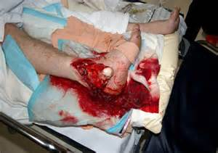
Tennis Shoes
ALWAYS WEAR BOOTS

Slide 69
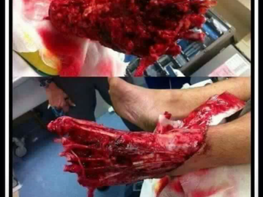
Never wear Flip Flops OR Sandals
They are not safe anytime you are on a bike

Slide 70
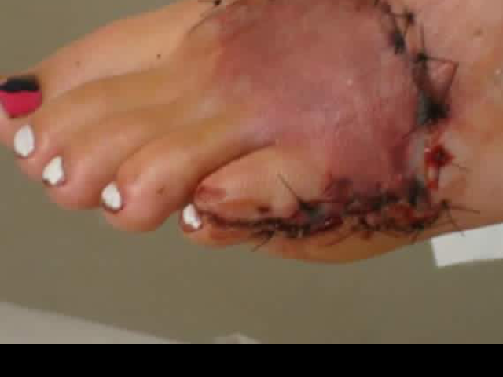
Watch getting off motorcycle with flip flops
Have your rider always wear boots also

Slide 71
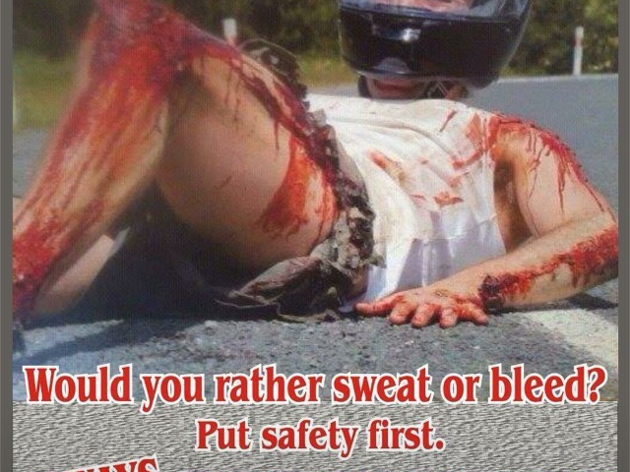
Wear long pants, no way it is summer
Long pants…GOOD…….Concrete ………..BAD

Slide 72
Watch behind you and stay in first gear at traffic lights and stop signs

Slide 73
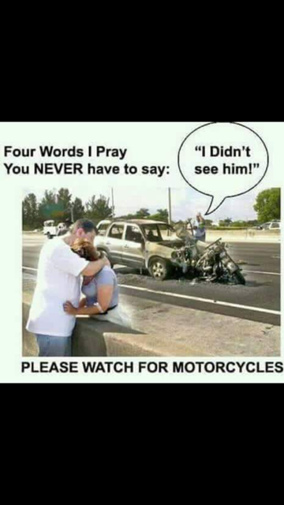
ALWAYS WATCH BEHING YOU

Slide 74
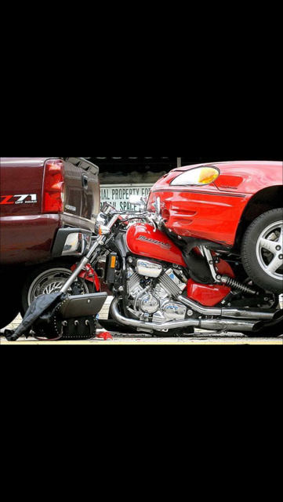

Slide 75
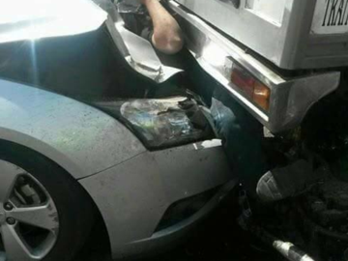
When stopped, keep bike in gear and watch behind you
Give yourself space and time to react

Slide 76
Summary
What is a Road captain?
Team Riding
Planning
Day of the ride prep
The Ride
Hand Signals
Questions?
Comments?

