Slide 1

Welcome to the…
Red KnightsInternational Firefighters
Motorcycle Club Inc.®
www.redknightsmc.com

Slide 2
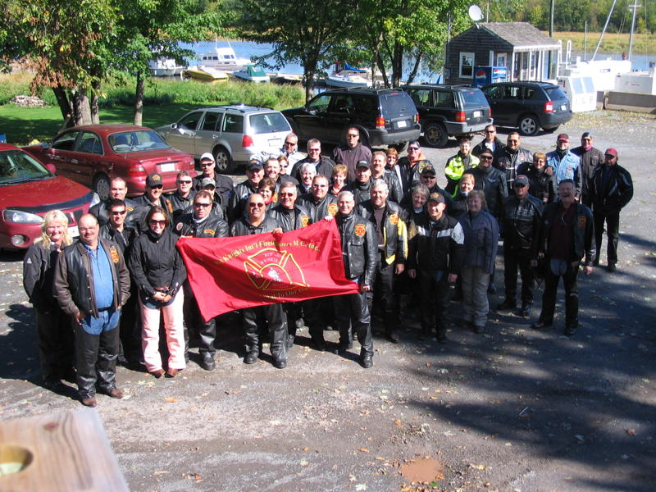
WE ARE..
FIREFIGHTERS and their FAMILIES and FRIENDS…

Slide 3
LOYAL TO OUR DUTY…
To promote motorcycle safety.
To project a positive image of motorcycling.
To enjoy the community of firefighters.
To engage exclusively in social, charitable and educational activities directed at increasing the general understanding of, enjoyment of, competency, sportsmanship and participation in the sport of motorcycling.

Slide 4
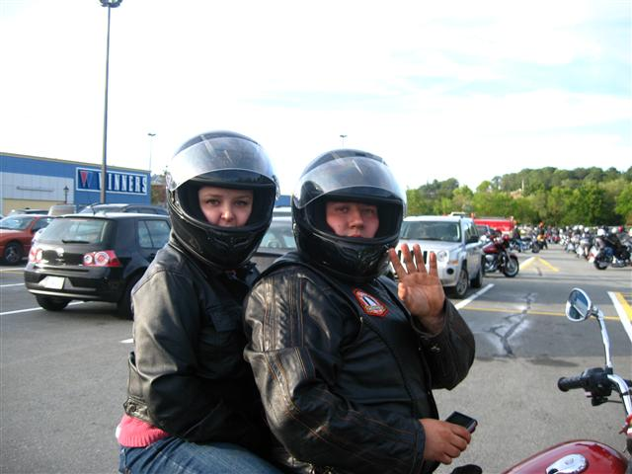
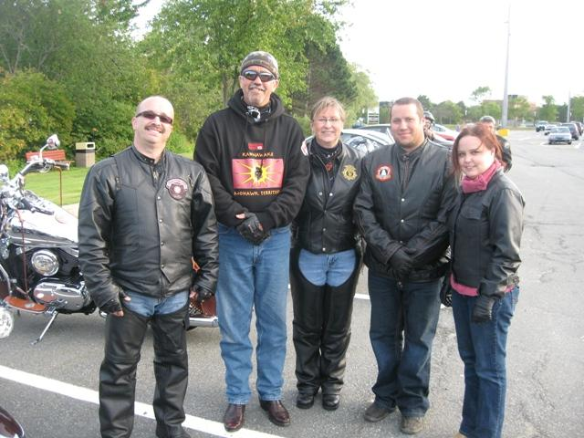
We are a club for members of the fire service and their families, who enjoy riding motorcycles.
Membership is open to ALL firefighters, active or retired, volunteer, or industrial, who have access to a motorcycle and hold a valid motorcycle drivers license.

Slide 5
Spouses, members' children, boy/girlfriends and brothers/sisters are also welcome as social members.
At present, a minimum of 7 firefighters are required to charter a new chapter.
Are you interested ?? …..

Slide 6
What’s it all about ?
Remember that we are working to develop an association where members can have FUN, SOCIALIZE and enjoy the FELLOWSHIP of other Red Knights® members!

Slide 7
It’s International….
Red Knights members are located in:
In the USA - Alabama, Arkansas, California, Colorado, Connecticut, Delaware, District of Columbia, Florida, Georgia, Idaho, Illinois, Indiana, Iowa, Kansas, Kentucky, Louisiana, Maine, Maryland, Massachusetts, Michigan, Minnesota, Mississippi, Missouri, Nebraska, Nevada, New Hampshire, New Jersey, New Mexico, New York, North Dakota, No. Carolina, Ohio, Oklahoma, Oregon, Pennsylvania, Rhode Island, So. Carolina, Texas, Tennessee, Utah, Vermont, Virginia, West Virginia, Washington and Wisconsin.
In Canada - Alberta, British Columbia, Prince Edward Island, Manitoba, Nova Scotia, Ontario, Newfoundland and Quebec
Around the world - New Zealand, Switzerland , Iceland, Ireland, Germany, Austria, Australia, England, Luxembourg, Wales, Serbia, Denmark, Netherlands, the Republic of Slovenia and Belgium

Slide 8
Are there costs?
Individuals may join as a Member at Large, or they may join existing chapters. Dues are $15 per year, USD, with a one time registration of $10
When sufficient local interest happens, a minimum of seven firefighters can form a new chapter.

Slide 9
How did it all start?
During the summer of 1982 several firefighters were visiting "Randy's Cycle Shop" in Boylston, Massachusetts and the subject of motorcycle clubs came up. Soon they were all grousing about the fact that law enforcement people had a motorcycle club known as the Blue Knights but there was no club for firefighters. After this tire kicking session, owner Randy Wilson suggested to Ed Wright, a firefighter from Northboro, MA, that he stop talking about the lack of a club and form one instead.

Slide 10
Then,…..
Recognizing a good idea when he heard one, Ed Wright went home that afternoon and made some hand printed posters inviting firefighters from the area to meet and determine if there was enough interest to form a motorcycle club. On August 17th, 1982, Fire Chief Jack Pierce allowed a small group of motorcycle enthusiasts to meet in Northboro Fire Headquarters to lay the ground work for the formation of a motorcycle club.

Slide 11
And next, ….
On October 19th, 1982, firefighters Colin Mackey, Bob Bourassa, Ed Wright, Roger Wentzell, Dave Hamilton, Bob Goulet, David Hunt, Jon Tripp, Don Parker, Norm Beausoleil and Chief Pierce met again. There was interest in promoting the positive image of motorcycling while enjoying the camaraderie of other firefighters. It was decided then that this group would be known as the Red Knights Motorcycle Club®

Slide 12
And then, -
News of this new club spread like a grass fire. In July of 1983, a chapter was formed in Connecticut. In October of that year a second Massachusetts chapter was formed. Soon applications came in from such distant places as Nevada and Louisiana. In August of 1983 the founding members realized the organization was rapidly growing beyond their original expectations. To properly handle this growth they elected a committee to serve as a national board of directors. With applications from Ontario and Saskatchewan, Canada, the club became the Red Knights International Firefighters Motorcycle Club.®

Slide 13
The result ? -
As a result of the seed that was planted at Randy's Cycle Shop in 1982, there are now more than 385 Red Knights® chapters and 9,200 members throughout the world, Check out our chapter locations page for the various chapter locations.

Slide 14
A sample of some RKMC FUN events -
Region 4 rally, the dixie, held the weekend after mother’s day each year
Region 5 rally, the Western, held in June
Region 6 rally, held in June
Ontario Association 6 rally, held in May
International Convention (North America) held in August
European International Convention held in September
KORT rally held in October
Additional Information: Watch the website for details www.redknightsmc.com

Slide 15
Charitable events -
RED KNIGHTS® of CONNECTICUT SHORELINE CHAPTER IV Annual Charity Ride -
Description: To benefit The Connecticut Burns Care Foundation (a camp for kids 8-18 that survived serious burns)
RED KNIGHTS® NC 6 ANNUAL RIDE FOR THE NC CHILDREN’S BURN CENTER

Slide 16
Charitable events
RED KNIGHTS® OHIO 5 Annual Charity Ride FOR RIDING HORSE FARMS
Description: To benefit The Paul Newman Hold in the Wall Foundation for disable children.
This is annual escorted multi state motorcycle ride raising over $120,000.00 for the last four years
www.flyinghorsefarms.org
MANY CHAPTERS HOLD EVENTS FOR A Multitude OF CHARTIES

Slide 17
Get the Idea ? -
FUN
FIREFIGHTER COMMUNITY
FAMILIES
FRIENDS
FIREFIGHTERS PROMOTING SAFETY IN MOTORCYCLING

Slide 18
Interested? -
Membership is open to all firefighters, active or retired, who have access to a motorcycle and hold a current valid motorcycle license. Spouses, members’ children, boy and/or girlfriends and brothers/sisters are also welcome for membership as social members. At present, a minimum of seven (7) firefighters is required to charter a new chapter.
Contact the International Secretary at secretary@redknightsmc.com for more information on joining the Red Knights®.

Slide 19
MEMBERS at LARGE
We understand that due to circumstances beyond your control, you may not be able to assemble a group of 7 potential members from your fire service who ride motorcycles. Because this situation may arise, and because we do not want to discourage any firefighter from joining our organization, we have a Member-At- Large status.

Slide 20
MEMBERS at LARGE
Members-At-Large must meet the same criteria for membership as a chapter member. The applicant must be in good standing in a fire service, paid, volunteer, or industrial. Their status may be active, retired, or disabled. Applicants must own or have access to a street legal motorcycle and be licensed to ride it. spouses or significant others are also welcome to join the club as social members.

Slide 21
MEMBERS at LARGE
As a Member-At-Large, you will have the same rights and responsibilities as a chapter member. You shall have the right to wear the club’s insignia and colors as regulated by the international executive board. You will receive all mailings that are sent to the chapters so that you may be well informed as to the activities and business of the club. In addition, you will periodically receive communications from the executive member responsible for Members-At-Large.

Slide 22
MEMBERS at LARGE
For complete information and application, go to http://www.redknightsmc.com/downloadablefiles.py and download the:
Members at Large Registration Packet

Slide 23
Thanks for taking this time to learn about us and visit our web site at www.redknightsmc.com

